Slide 1


PYTHON
Lecture 43

Slide 2

Today’s Agenda
Advance Concepts Of Object Oriented Programming-I
Encapsulation
Does Python Support Encapsulation ?
How To Declare Private Members In Python ?
The setattr( ) And getattr( ) Functions
The object Class And The __repr__() Method
The Destructor

Slide 3
Encapsulation
Encapsulation is the packing of data and functions operating on that data into a single component and restricting the access to some of the object’s components.
Encapsulation means that the internal representation of an object is generally hidden from view outside of the class body.

Slide 4
Is The Following Code Supporting Encapsulation ?
No , the following code is violating Encapsulation as it is allowing us to access data members from outside the class directly using object
class Emp:
def __init__(self):
self.age=25
self.name="Rahul"
self.salary=30000.0
e=Emp()
print("Age:",e.age,"Name:",e.name,"Salary:",e.salary)
Output:

Slide 5
How To Achieve Encapsulation In Python ?
To achieve Encapsulation in Python we have to prefix the data member name with double underscore
Syntax:
self.__<var_name>=<value>

Slide 6
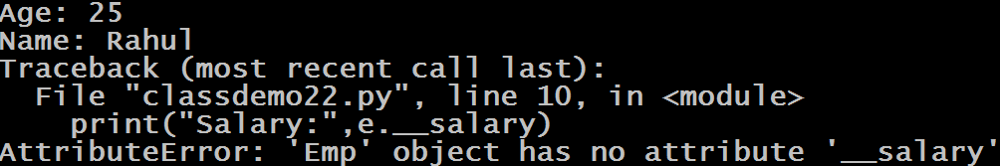
Achieving Encapsulation
Since we have created the data member as __salary so it has become a private member and cannot be accessed outside the class directly
class Emp:
def __init__(self):
self.age=25
self.name="Rahul"
self.__salary=30000.0
e=Emp()
print("Age:",e.age)
print("Name:",e.name)
print("Salary:",e.__salary)
Output:

Slide 7
Achieving Encapsulation
Now to access such private members , we must define instance methods in the class
From outside the class we must call these methods using object instead of directly accessing data members

Slide 8
Achieving Encapsulation
class Emp:
def __init__(self):
self.__age=25
self.__name="Rahul"
self.__salary=30000.0
def show(self):
print("Age:",self.__age,"Name:",self.__name,"Salary:",self.__salary)
e=Emp()
e.show()
Output:

Slide 9
Private Methods
Just like we have private data members , we also can have private methods .
The syntax is also same.
Simply prefix the method name with double underscore to make it a private method

Slide 10
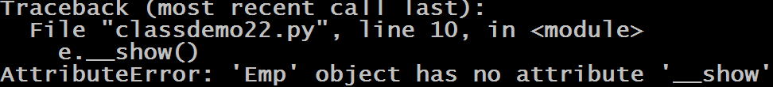
Private Methods
class Emp:
def __init__(self):
self.__age=25
self.__name="Rahul"
self.__salary=30000.0
def __show(self):
print("Age:",self.__age,"Name:",self.__name,"Salary:",self.__salary)
e=Emp()
e.__show()
Output:

Slide 11
An Important Point
When we declare a data member with double underscore indicating that it is private , Python actually masks it
In other words , Python changes the name of the variable by using the syntax _<classname>__<attributename>
For example , __age will actually become _Emp__age

Slide 12
So, What It Means To Us ?
This means that private attributes are not actually private and are not prevented by Python from getting accessed from outside the class.
So if they are accessed using the above mentioned syntax then no Error or Exception will arise
So , finally we can say NOTHING IN PYTHON IS ACTUALLY PRIVATE

Slide 13
Accessing Private Data
class Emp:
def __init__(self):
self.__age=25
self.__name="Rahul"
self.__salary=30000.0
def show(self):
print("Age:",self.__age,"Name:",self.__name,"Salary:",self.__salary)
e=Emp()
e.show()
print("Age:",e._Emp__age,"Name:",e._Emp__name,"Salary:",e._Emp__salary)
Output:

Slide 14
The setattr() And getattr() Functions
The setattr() method sets the value of given attribute of an object.
The syntax of setattr() method is:
setattr(object, name, value)
The setattr() method takes three parameters:
object - object whose attribute has to be set
name - string which contains the name of the attribute to be set
value - value of the attribute to be set

Slide 15
The setattr() And getattr() Functions
The getattr() method returns the value of the named attribute of an object.
If not found, it returns the default value provided to the function.
The syntax of getattr() method is:
getattr(object, name, [default value])
The getattr() method returns:
value of the named attribute of the given object
default, if no named attribute is found
AttributeError exception, if named attribute is not found and default is not defined

Slide 16
Example
class Data:
pass
d = Data()
d.id = 10
print(d.id)
setattr(d, 'id', 20)
print(d.id)
Output:
10
20

Slide 17
Benefit Of setattr() Function
The setattr() function is useful in dynamic programming where the attribute name is not known at the time of writing the code.
In that case, we can’t use the dot operator.
For example, taking user input to set an object attribute and it’s value.

Slide 18
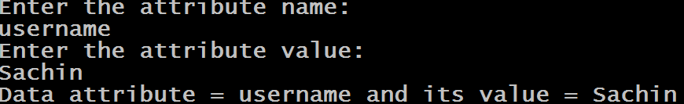
Example
class Data:
pass
d = Data()
attr_name = input('Enter the attribute name:\n')
attr_value = input('Enter the attribute value:\n')
setattr(d, attr_name, attr_value)
print('Data attribute =', attr_name, 'and its value =', getattr(d, attr_name))
Output:

Slide 19
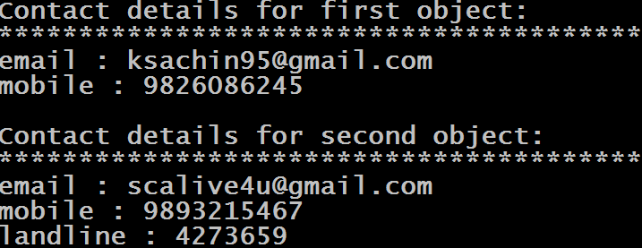
Exercise
Write a program to create a class called Contact having 2 methods:
Now provide following methods in your class
__init___() : This method should initialize instance members with the parameter passed. Allow user to pass as many data members as he wants
show(): Display the names of all the instance variables as well as their values
Finally , in the main script , create 2 Contact objects , initialize them and display the data
Output:

Slide 20
Solution
class Contact:
def __init__(self,**kwargs):
for key,value in kwargs.items():
setattr(self,key,value)
def show(self):
for key in self.__dict__.keys():
print(key,":",getattr(self,key))
c1=Contact(email='ksachin95@gmail.com',mobile=9826086245)
c2=Contact(email='scalive4u@gmail.com',mobile=9893215467,landline=4273659)
print("Contact details for first object:")
print("*"*40)
c1.show()
print()
print("Contact details for second object:")
print("*"*40)
c2.show()

Slide 21
The __repr__() Method
In Python , whenever we try to print an object reference by passing it’s name to the print() function , we get 2 types of outputs:
For predefined classes like list ,tuple or str , we get the contents of the object
For our own class objects we get the class name and the id of the object instance (which is the object’s memory address in CPython.)

Slide 22
Why Is It So ?
This is because whenever we pass an object reference name to the print() function , Python internally calls a special instance method available in our class.
This method is called __repr__() .

Slide 23
From where this method came ?
From Python 3.0 onwards , every class which we create always automatically inherits from the class object
Or , we can say that Python implicitly inherits our class from the class object.
The class object defines some special methods which every class inherits .
Amongst these special methods some very important are __init__(), __repr__(),__new__() etc

Slide 24
Can we see all the members of object class ?
Yes , it is very simple!
Just create an instance of object class and call the function dir( ) .
Recall that we used dir( ) to print names of all the members of a module .
Similarly we also can use dir( ) to print names of all the members of any class by passing it the instance of the class as argument

Slide 25
Example
obj=object()
print(type(obj))
print(dir(obj))
Output:

Slide 26
The __repr__() Method
Now , if we do not redefine (override) this method in our class , then Python calls it’s default implementation given by object class which is designed in such a way that it returns the class name followed by object’s memory address
However all built in classes like list , str , tuple , int , float , bool etc have overridden this method in such a way that it returns the content of the object.

Slide 27
Overriding __repr__()
So if we also want the same behaviour for our object then we also can override this method in our class in such a way that it returns the content of the object.
The only point we have to remember while overriding this method is that it should return a string value

Slide 28
Overriding __repr__()
class Emp:
def __init__(self,age,name,salary):
self.age=age
self.name=name
self.salary=salary
def __repr__(self):
return f"Age:{self.age},Name:{self.name},Salary:{self.salary}"
e=Emp(25,"Rahul",30000.0)
print(e)
Output:

Slide 29
Destructor
Just like a constructor is used to initialize an object, a destructor is used to destroy the object and perform the final clean up.
But a question arises that if we already have garbage collector in Python to clean up the memory , then why we need a destructor ?

Slide 30
Destructor
Although in python we do have garbage collector to clean up the memory, but it’s not just memory which has to be freed when an object is dereferenced or destroyed.
There can be a lot of other resources as well, like closing open files, closing database connections etc.
Hence when we might require a destructor in our class for this purpose

Slide 31
Destructor In Python
Just like we have __init__() which can be considered like a constructor as it initializes the object , similarly in Python we have another magic method called __del__().
This method is automatically called by Python whenever an object reference goes out of scope and the object is destroyed.

Slide 32

Guess The Output ?
Since at the end of the code , Python collects the object through it’s garbage collector so it automatically calls the __del__() method also
class Test:
def __init__(self):
print("Object created")
def __del__(self):
print("Object destroyed")
t=Test()
Output:

Slide 33
How To Force Python To Call __del__() ?
If we want to force Python to call the __del__() method , then we will have to forcibly destroy the object
To do this we have to use del operator passing it the object reference

Slide 34

Guess The Output ?
class Test:
def __init__(self):
print("Object created")
def __del__(self):
print("Object destroyed")
t1=Test()
del t1
print("done")
Output:

Slide 35

Guess The Output ?
We must remember that Python destroys the object only when the reference count becomes 0 . Now in this case after deleting t1 , still the object is being refered by t2 . So the __del__() was not called on del t1. It only gets called when t2 also goes out of scope at the end of the program and reference count of the object becomes 0
class Test:
def __init__(self):
print("Object created")
def __del__(self):
print("Object destroyed")
t1=Test()
t2=t1
del t1
print("done")
Output:

Slide 36
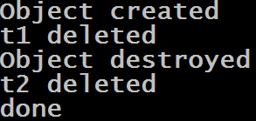
Guess The Output ?
class Test:
def __init__(self):
print("Object created")
def __del__(self):
print("Object destroyed")
t1=Test()
t2=t1
del t1
print("t1 deleted")
del t2
print("t2 deleted")
print("done")
Output:

